Slide 1
Workshop CityGML WP9 Other constructions
Linda van den Brink
15/16 October 2014

Slide 2
Day 2
Whole group: create a list of discussion items, and a logical order for discussing them.
Discuss the items one by one
16:00 at the latest: discuss process related things, revisit timeline etc.

Slide 3
Discussion items
Definition of OtherConstruction / _Site classes and, if we keep it, CityFurniture class
Tunnel and Bridge / parallel or subclass
Naming of classes (_Site and OtherConstruction)
Keep or remove CityFurniture class
Common attributes at _Site level
Specific attributes
Levels of detail:
geometric representations (which kinds?)
implicit representations
interior?
Semantic structure, e.g. parts

Slide 4
Things to keep in mind for later
Relationship with utility networks model
Relationship with WP3 (levels of detail)
Relationship with WP14
Walls proposal: check the details. Is there a (detailed) proposal for semantics etc?
Relationship with INSPIRE (Building theme and Activity Complex / Production & Industrial Facilities / Agricultural Facilities)

Slide 5
Deliverables
Text for chapter in CityGML standard documentation
Explanation of the model
Conformance requirements
UML model for Other Constructions module
Codelists, either normative or informative.
Example(s)?

Slide 6
How to get there
Overview of ideas, requirements of participants – this workshop
Discussion – this workshop
Consensus on scope of Other Constructions
Work out details
Work on model and specs
Negotiate with other WPs
Submit to SWG

Slide 7
Timeline
March 2015
Draft constructions
module ready
June 2015
Module submitted to SWG
End of 2014
Consensus reached
October – December 2014
January – March 2015
March – June 2015
Discussion phase
Scope
Definitions
Details
Work phase
Detailed proposals for parts of module
Drafting text
Creating UML model
Integration phase
Negotiation with other WPs

Slide 8
Other constructions proposal for new CityGML module
Linda van den Brink
15 October 2014
Based on a presentation prepared together with IGN France and presented at Abu Dhabi OGC meeting, March 2013.

Slide 9
Why?
Some constructions to be modeled in 3D are neither buildings or building parts, nor city furnitures
Issue identified in Geonovum IMGeo, INSPIRE Building data spec, IGN BATI3D product, French Defense CityGML profile
Dutch IMGeo ADE identifies 3 types of other constructions
Built structures that do not match the definition of building (sheds, bunker, tanks…)
Engineering structures, that can’t be considered city furnitures (pylons, locks, dams, culverts…)
Linear separation features (fences, walls…)

Slide 10
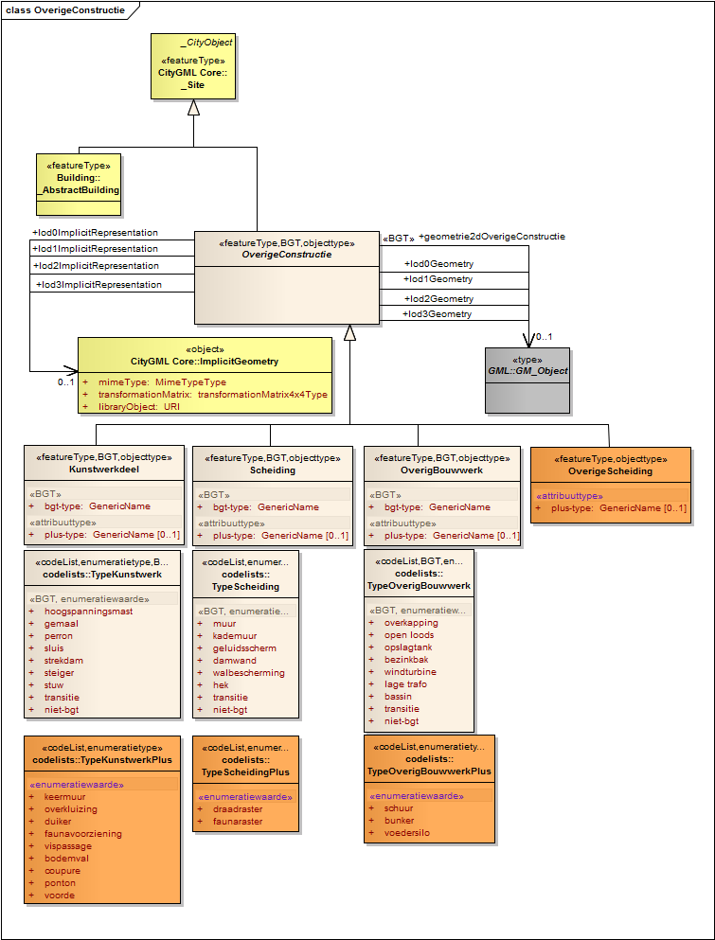
Other constructions in IMGeo ADE

Slide 11
Classifying ‘other built objects’ “A Built object, permanent and connected to the earth, which is not a building or engineering structure”
span structure | A separate (i.e. not being part of a building) roof resting on columns.
open shed | Fixed (unmovable) light building with an open façade, with the purpose of storage or workspace or as temporary roofing for other purposes.
storage tank | Storage facility for liquids. Only above ground tanks are part of IMGeo.
settling vat | Closed reservoir in which waste water is temporarily stored and which contains a cleaning facility.
wind turbine | Turbine which transforms wind pressure into mechanical energy.
Transformer vault | Built object containing tranformers for electricity supply
open basin | Water basin, like a swimming pool
bunker | Military defense structure offering protection against bullets and bombardments
forage silo | Storage facility for animal feed, being a vertical container with an opening at the bottom.
shed | Free standing, possibly prefabricated, built object for which a building permit is not required, used for storage or work space.

Slide 12
Classifying civic engineering structures
“A built object for the infrastructure of roads, water, railways, or utilities”
high-tension line tower | Metal tower or pylon supporting cables for the transport of electricity with a high voltage.
pump works | Engineering structure with the purpose of bringing water from a low to a high level
railway platform | Heightened construction along a railway track for entering/leaving of passengers or for (un)loading of goods.
lock | Artificial, movable construction with doors or a sliding construction for closing or opening the connection between two water surfaces.
longitudinal dyke | Construction in the water for defense of the coast or bank
wharf | Fixed (non floating) engineering construction where ships can berth and be (un)loaded from land
weir | Construction with a fixed sill or a movable valve with the purpose of controlling the water level upstream and downstream.
retaining wall | A stiff construction with a large weight and broad footing for stopping soil or water. The building material is usually, but not always, reinforced concrete.
overkluizing [no translation yet] | Construction with which a road spans another road, a square or a water surface. In the case of a water surface often ships cannot pass under the structure, but the water surface is still free. The structure is like a bridge, but usually it is not covered by a traffic area but by one or more buildings. Usually it is not part of the road network.
culvert | Construction for water management, in the form of a tube under a road or railway or in a dyke to allow water to pass.
fauna facility | Facility at a road or railway with the purpose of preventing or reducing the negative effects of the road or railway for animals.
fish passage facility | Artificial construction allowing fish to pass engineering structures in waterways.
check | Drop in the bed of a waterway.
cut | Interruption in a dyke for the passage of a road or railway, which can be closed in the event of extreme high water.
pontoon | Floating, closed container, sometimes covered with a deck (flooring)
ford | Shallow, usually hardened place in a waterway where it can be crossed.

Slide 13
Classifying separations “Artificial, usually linear obstacle with a function of preventing passage”
wall | Separation made of stone
quay wall | Verticale wall for the separation of land and water, constructed of masonry or concrete.
noise barrier | Separation with a function of reducing noise outside
sheet pile | Earth retaining construction being a vertically placed wall.
shoring | Almost vertical wall for the purpose of retaining earth and preventing avulsion by water, not being a quay wall.
fence | Enclosure, usually a barrier between yards
wire fence | Fence constructed of usually wooden, metal or synthetic poles with one or more wires connecting them.
fauna fence | Separation of metal wire between poles, with the purpose of leading animals.

Slide 14
How - modeling
Move common attribs to Abstract Site?
class
function
usage
yearOfConstruction
yearOfDemolition
implicitGeometry

Slide 15
How – modeling & subclasses
LOD0, 1, 2 & 3
Geometry
LOD1, 2 & 3
Implicit Representation
0..1
0..1

Slide 16
Analysis of definitions of ‘Building’
« other constructions » are defined in contrast to « buildings »
However, CityGML does not define buildings
Other semantic sources
IMGeo/NEN (Netherlands)
INSPIRE Building Data Specification
Ordnance Survey (Great Britain)
DGIWG Data Dictionary (DFDD)
SIG3D (Germany)
Building characteristics have been identified and compared:
Roofed
Permanent
With foundation / Connected to earth / not portable/movable
Enclosed (with walls)
Function
Free-standing

Slide 17
What is a building?
 | Ordnance Survey | INSPIRE | DGIWG | IMGeo / BAG | NEN 3610 | BRT / Top10NL | Sig3D
Roofed | X |  | X |  | X | X | X
Permanent | X | X |  | X |  | X
With foundation | X
Connected to earth / not portable/movable | X |  | X | X | X | X | X
Enclosed |  | X |  | X | X | X
Function |  | shelter provision | human occupancy or habitation | accessible to humans |  | Accommoda-tion for commerce, traffic or labor | human occupancy, habitation or shelter provision
Free-standing |  |  | X |  | X | X | X

Slide 18
What is an ‘Other construction’?
Identified characteristics:
With foundation / Connected to earth / not portable/movable
To be distinguished from building installations (e.g. on roofs)
Does not need to be enclosed
Free-standing
Function : support of human activities
Classification defined by Geonovum as a starting point
Built structures
Engineering structures
Linear separation features

Slide 19
Summary
Possible characteristics of a “building”
Roof
Walls
Self-supporting
Function (mainly human occupancy)
Permanent
Possible characteristics of an “other construction”
Not necessarily roofed
Not necessarily entirely enclosed by walls
Self-supporting
Function (support of human activities, not for human occupancy)

Slide 20
Discussion items
Scope of « other constructions »
Different classifications in INSPIRE Building spec and IMGeo
Silos, tanks, windmills… are buildings in INSPIRE
INSPIRE also has a thematic structure that differs from CityGML
E.g. hydro constructions are dealt with in the Hydro spec
Utility types of constructions are in a separate module
Transverse objects
Object Wall could be classified in EngineeringStructurePart, Separation or CityFurniture, depending on its function
General rule “A Wall is always a Separation object” or function-dependant mapping?

Slide 21
Other discussion items II
Attribution
ImGeo ADE has class/function attributes
In INSPIRE, some common attributes with buildings:
Date of construction
Date of demolition
Height
Define in a common superclass for other constructions and buildings?
In Defense spec, common attributes:
Manufacturing information
Physical condition
Height
Geometric modeling
“Regular” and implicit geometries
Small and big constructions → 4 LODs not necessary for all objects

